Slide 1



Slide 2


Slide 3

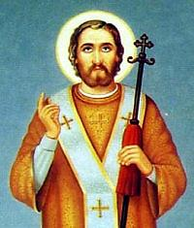
St. John
Chrysostom

Slide 4
John Chrysostom, Archbishop of Constantinople,
was an important Early Church Father.
He is known for his eloquence in preaching and public speaking.
Born: AD 347, Antioch Died: September 14, 407 AD, Comana, Pontus
When Libanius (Heathen) was asked whom he considered his successor, he answered sadly: "John, of course, had not the Christians taken him away from us." And even of St. John’s mother, Libanius had this to say: "What worthy women these Christians have!"

Slide 5
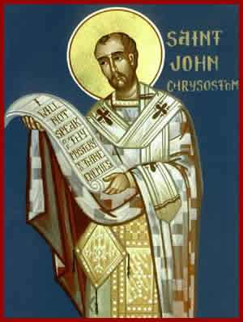
His father died early.. He longed for monasticism but his mother was against it.
Meletius, the Bishop of Antioch, heard about John’s unusual gifts and took him into the ranks of clergy.
After his mother’s departure, lived in wilderness for 4 years.
Illness returned him to service 12 years in Antioch.
The fame of St. John as "Chrysostom"
rang throughout the Christian world.
The title, which in Greek means
"golden-tongued," was given to the
saint because of his divinely inspired and eloquent discourse.

Slide 6
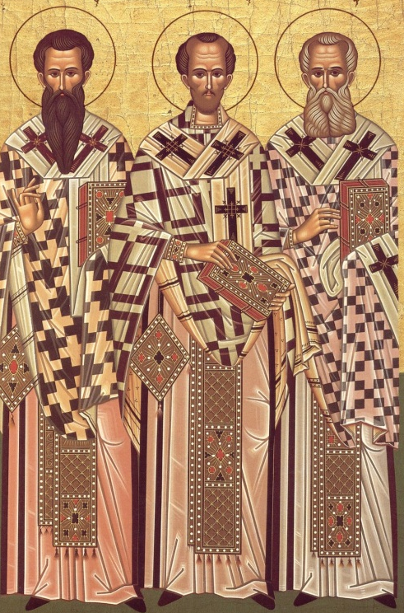
Very often his sermons were interrupted by applause. John would stop the audience saying, "What is your applause to me? Correcting your lives and turning to God — that is my best praise from you."
After departure of Bishop Nectary
(Predecessor of Bishop Gregory the
Theologian) Emperor Arcady assigned
St John to the Bishopric.
Empress Eudoxia was angered at his sermons because she loved vanity. She conspired about him with angry bishops and issued his exile.

Slide 7
"The Church of Jesus Christ was not begun by me and will not be ended by me," said John to his loyal friends.
The very night he left, there occurred a strong earthquake and terrified Eudoxia begged Chrysostom to return at once.
After 2 months Eudoxia gave in to her passions and vices as she had previously, and John stepped forward with words of accusation once again.
This time John was condemned behind his back and sent into exile. For 3 years John suffered fierce wars on foot through the mountains, heat and teeming rain.

Slide 8
Totally enfeebled, the Holy one stopped in the town of Komanah. Here at night the Holy Martyr Basilik (whose relics were venerated in this town) appeared and said, "Do not be saddened brother John, tomorrow we shall be together." John partook of Holy Communion and died peacefully with these words: "Thank God for everything!"

Slide 9


Slide 10

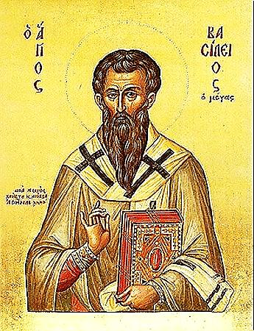
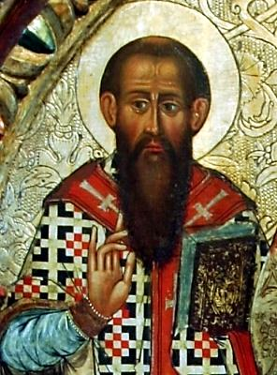
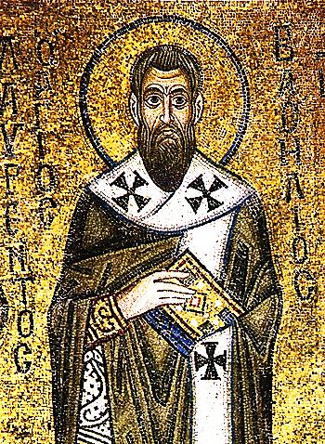
St Basil
The Great

Slide 11
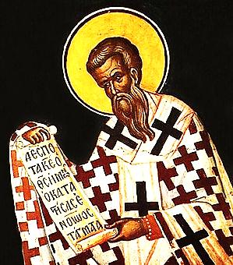
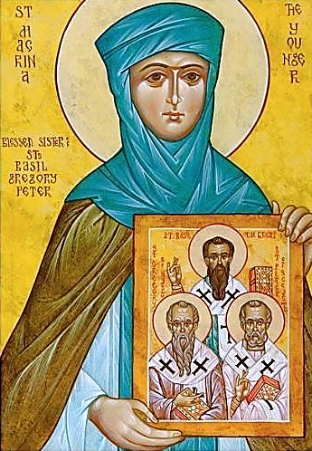
Basil of Caesarea,
also called Saint Basil the Great,
was the Greek bishop of Caesarea Mazaca in Cappadocia, Asia Minor.
Born: AD 330, Caesarea Mazaca Died: January 1, 379 AD, (49 Years Old) Siblings: Gregory of Nyssa Saint Macrina

Slide 12
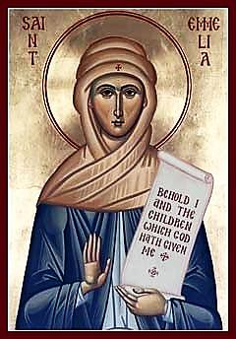
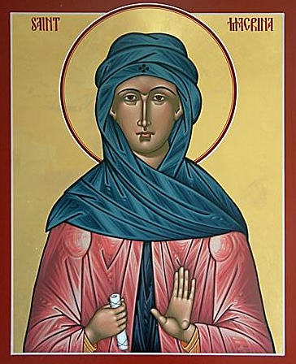
St Basil’s Christian and righteous parents are :
Father : Basil Mother: Emelia
Son of St Macrina
The Elder

Slide 13
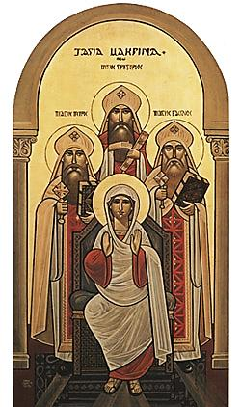
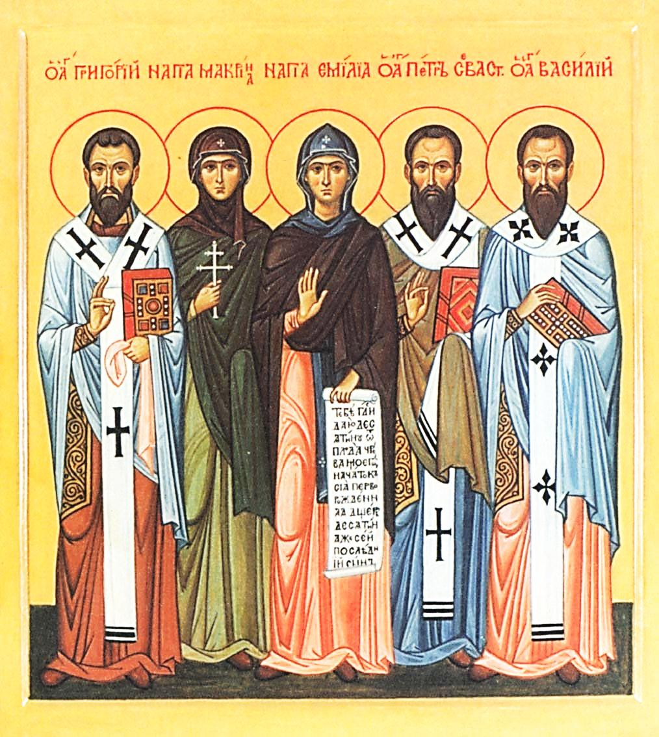
Family Portraits
St. Gregory, St. Macrina, St. Emmelia,
St. Peter of Sebaste, St. Basil the Great

Slide 14
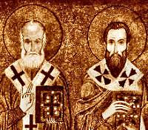
With the guidance of his older sister St Macrina,
St Basil became an ascetic monk in Athens along with his intimate friend St Gregory The Theologian.

Slide 15
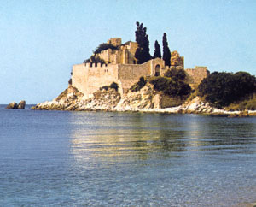
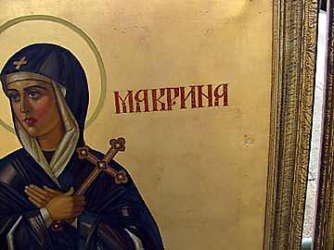
He organised the monastic life by setting rules for prayer, work, study and guidance.
St Basil’s Hermitage 
On Iris River
(Pontus) near his mother
And sister’s hermitage.
He established a monastery for nuns under the leadership of his sister St. Macrina.

Slide 16
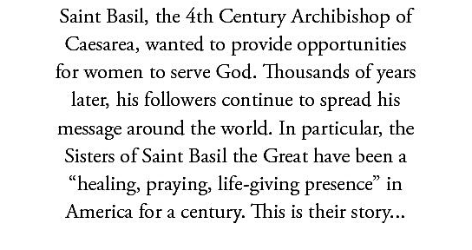
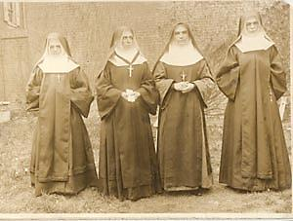
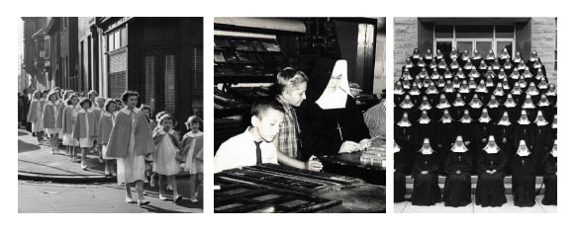
Article from American newspaper.
28/11/1911
1947 1977

Slide 17
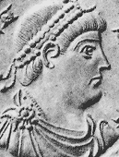
St Basil defended the faith against Aryanism before the Arian Emperor Valens
St Basil became famous and was ordained
An Archbishop of Caesarea of Cappadocia
In 370AD (for 8 years).
Valens aroused great persecution against
Christians. St Basil confirmed and
Strengthened the people.
Valens threatened to: 1. Confiscate his possessions
2. Send him to exile
3. Torture him
4. Kill him

Slide 18
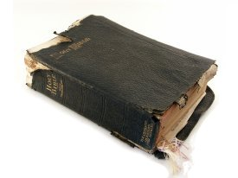
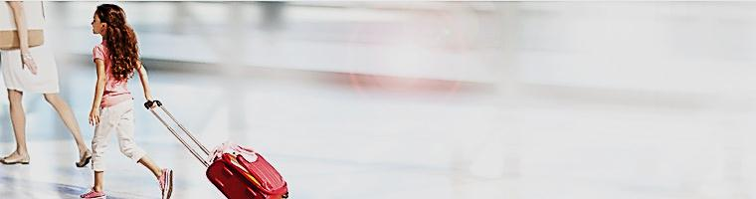
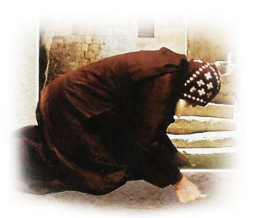

St Basil was not frightened in any way and responded to each of the threats as follows:
Nothing to confiscate except some old clothes and some books
(Ascetism and detachment from the materialistic world)
2. All the land are as a house of sojourn
(transit till we reach our real and
everlasting Home of comfort)
Torture could not frighten a body that has already died (a monk has died to the world and the funeral prayer is prayed on them)
Death is a friend which would accompany me
on my final journey to the true homeland.

Slide 19

Valens became very angry and ordered the exile of St Basil. As the carriage was waiting for him at the door, suddenly Valens reversed the decision because his only son died and Valens’ wife believed the reason was the exile of the saint. She sent asking St Basil to pray for her son.
St Basil asked if Valens was ready to baptise the child in the orthodox faith and he promised.
After the child was restored to life, Valens baptised him in the Arian faith and the child shortly died.

Slide 20
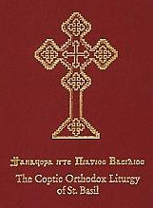
St Basil the Great wrote the well known Liturgy of St Basil which is used by our church today.

Slide 21

Valens counsellors convinced him to exile St Basil since he would not accept Arians into communion.
He wanted to sign the exile decree but his pen broke three time, he was angered and declined the exile.
St Basil departed in peace at the age of 49.

Slide 22
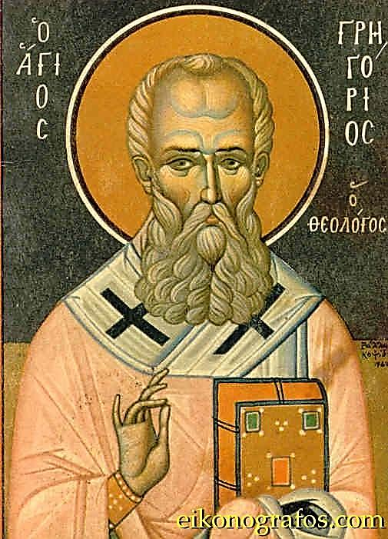
St Gregory
The Theologian

Slide 23
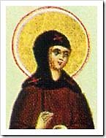
Gregory of Nazianzus was a 4th-century Archbishop
of Constantinople.
He is widely considered the most accomplished
rhetorical stylist of the patristic age.
Born: AD 330, Cappadocia Died: January 25, 390 AD Siblings: Saint Caesarius of Nazianzus Saint Gorgonia

Slide 24
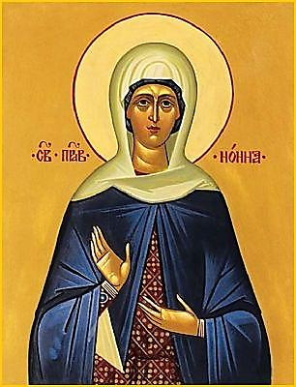
St Gregory ‘s parents were Christian and righteous.
Father: St Gregory the Elder Mother: St Nonna

Slide 25
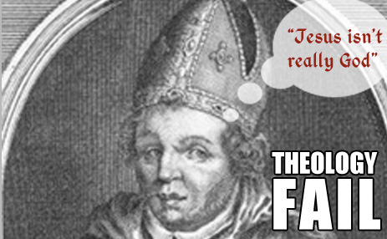

After he became a monk with his friend St Basil in a hermitage in Pontos, he reluctantly had to leave and become a priest to assist his father St Gregory the elder who was a bishop of Nazianzus.
By the age of 30, he was more famous than his father in defending the faith against heresies.
He was responsible for the church after his father’s departure.
Soon after, Valens died and his best friend St Basil departed.
He was called to be a bishop of Constantinople where the church was torn by Arians within and pagans without.

Slide 26
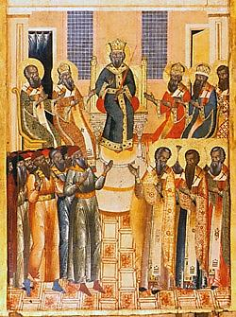
Each week, thousands of people returned to the Orthodox Church from heresy.
After the enthronement of the Christian Emperor Theodosius
(379-395), Arians were banished from the Churches of the capital.
St. Gregory defended the faith in the Second
Ecumenical Council.
(The heresies of Macedonianism
and Apollinarianism, off-shoots
of the Arian heresy)

Slide 27
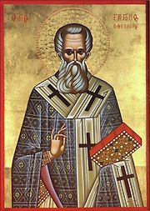
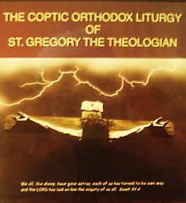
Having completed his works, he refused the see of Constantinople, saying "Farewell my Cathedral—it is an enviable and perilous height."
St. Gregory went to the town of Arianza near Nazianzen, and here in strict ascetic deeds he passed the last years of his life. Departed at the age of 63.
He wrote the Liturgy
of St Gregory used
by our church today.

Slide 29

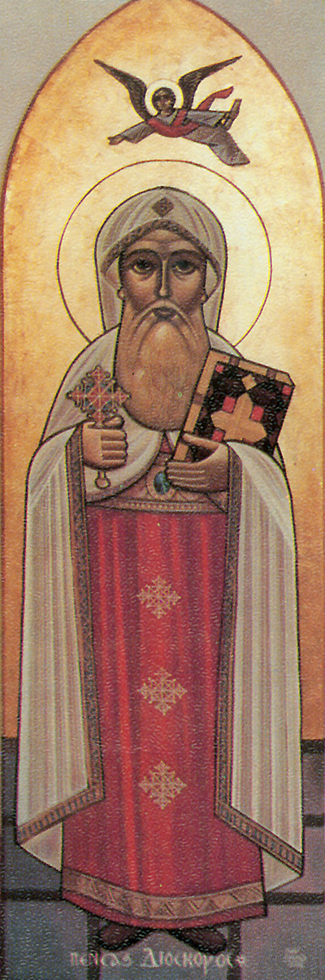
St Discorous 25th pope of Alexandria

Slide 30

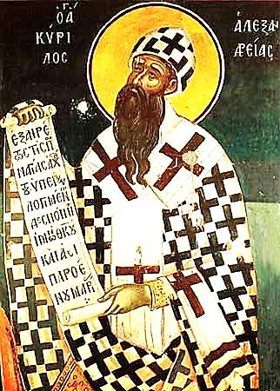
The empress commanded to smite St. Dioscorus on his mouth, and to pluck out the hair of his beard.
He took the hair and the teeth that were knocked out and sent them to Alexandria saying, "This is the fruit of Faith.”
When the rest of the bishops saw what had happened to Dioscorus, they agreed with the emperor, being afraid of undergoing the same fate. They signed the document of the belief that Christ has two distinct and separate natures.
When St. Dioscorus knew this, he sent
for the document and pretended that he wanted to
sign it too. But when he read the document, he wrote
at its foot that he excommunicated everyone who had
signed it, as well as everyone who deviated from the
Orthodox Faith.

Slide 31
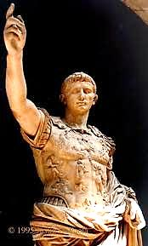
The emperor was enraged and he commanded to
banish St. Dioscorus to the island of Gagra.
When they took St. Dioscorus to the island of Gagra,
its bishop, because he was a Nestorian, met him with
contempt and disdain. However, God performed at the
hands of St. Dioscorus many great signs and wonders,
so that all obeyed him, respected and revered him
Greatly.
St. Dioscorus, having ended his good fight, he departed
on the island of Gagra.

Slide 32
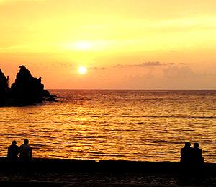
Paphlagonia (Παφλαγονία)
Ancient Region of Anatolia
Nature of Amasra
Location | North central Anatolia
State existed | 5th c-183 BC
Language | Paphlagonian
Historical capitals | Gangra
Roman province | Pontus

