Slide 1
The Sacraments of the coptic orthodox church

Slide 2
What is a sacrament?
The Church Sacrament is an invisible grace we receive by practicing a visible rite, and a visible sign or substance performed by a priest.

Slide 3
Purpose of Sacraments
The Holy Spirit works in the Church through the Sacraments, giving us His gifts, blessing and comfort, and teaches us and guides us to the way of truth.
(John 14:26)“ but the comforter, the Holy Spirit, whom the father will send in My name, He will teach you all things ….I said to you”

Slide 4
What Are The Sacraments?
What are the visible substances of the Sacraments?

Slide 5
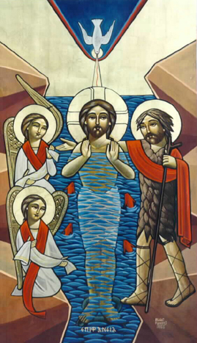
Sacrament of Baptism
In the Baptism the substance is Water by which we receive the second birth from water and Spirit.

Slide 6
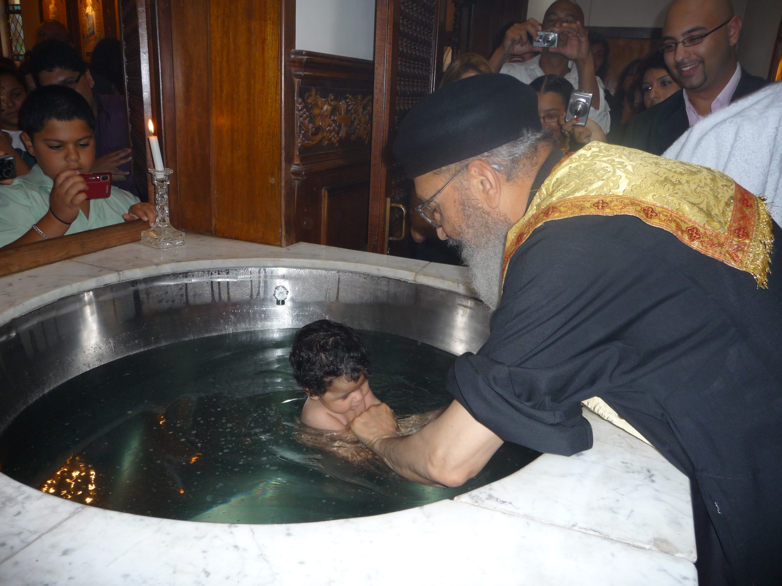
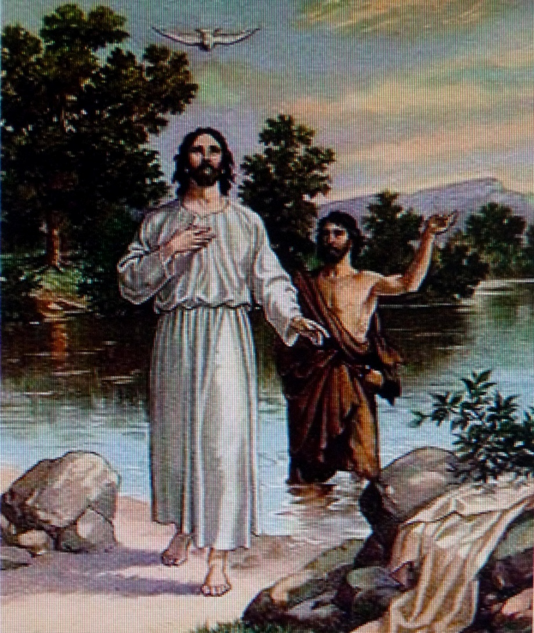

Slide 7
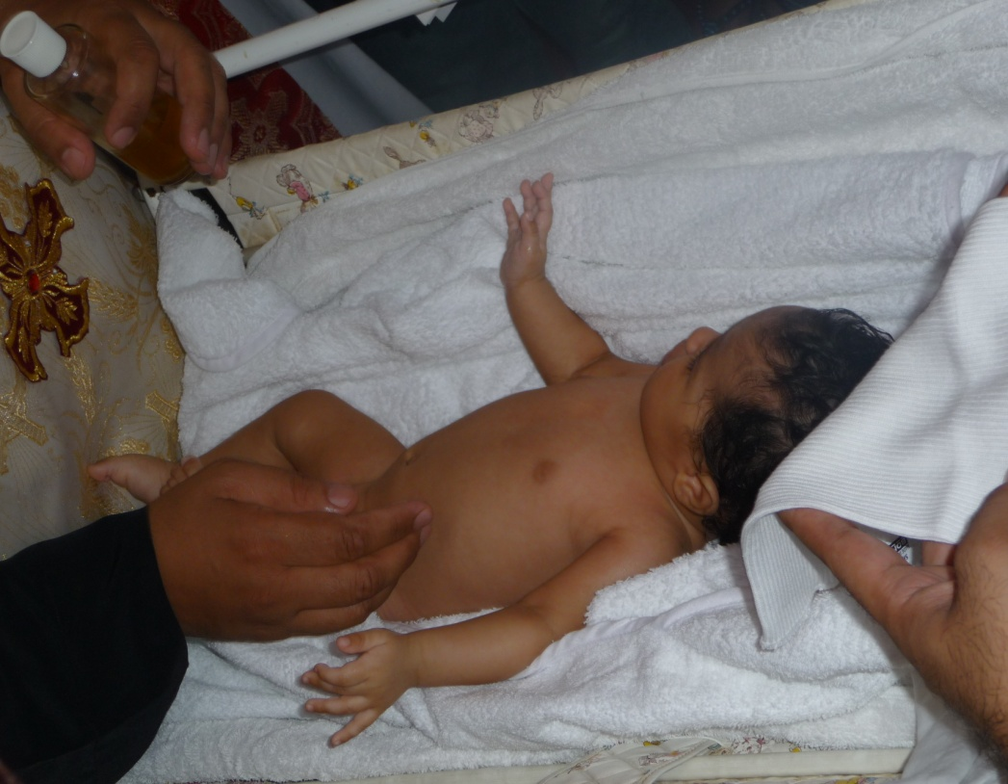
Sacrament of Confirmation.
In the confirmation the substance is the oil of Myron, by which the Holy Spirit dwells in us.

Slide 8
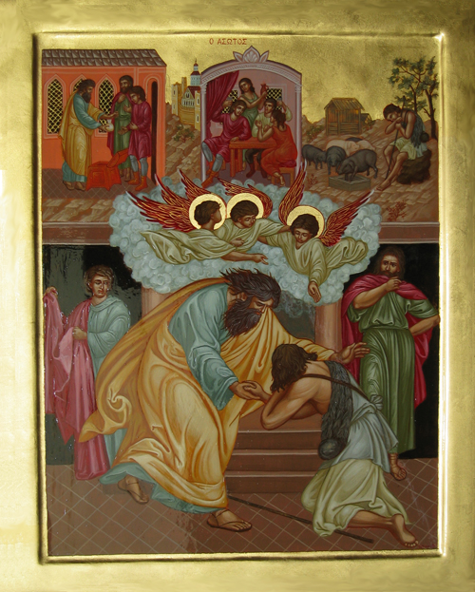
Sacrament of Confession.
The sign of the Sacrament of confession is the confessing person, who accepts the prayer of absolution at the end of Confession to gain forgiveness of sins.

Slide 9
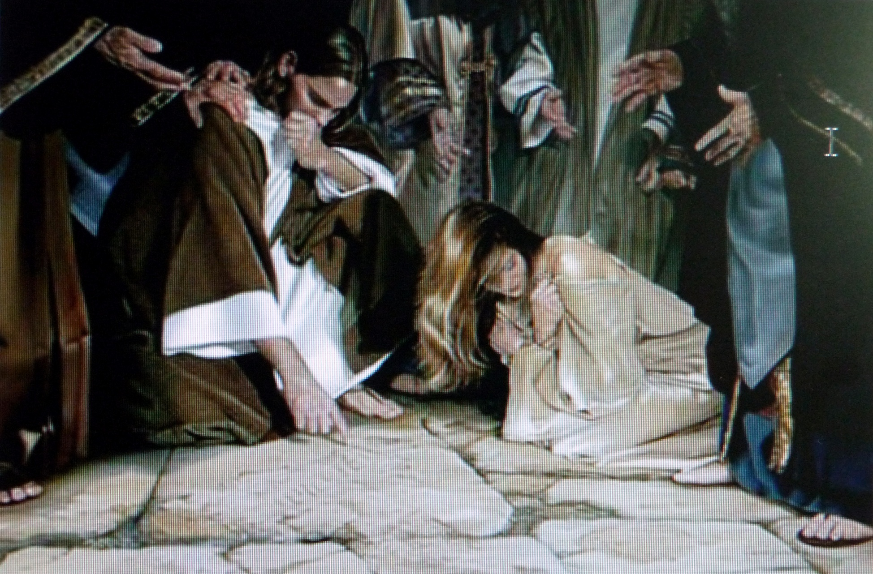
Sacrament of Confession.

Slide 10
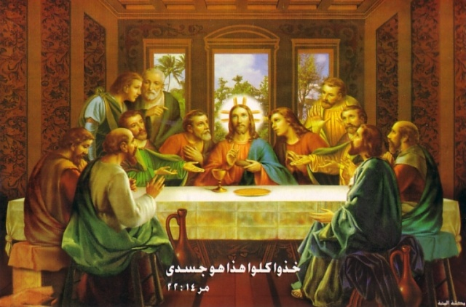
Sacrament of Eucharist.
The substance of the Sacrament of Communion is the bread and wine, by which we eat the Holy Body and Precious Blood of Emmanuel our God.

Slide 11
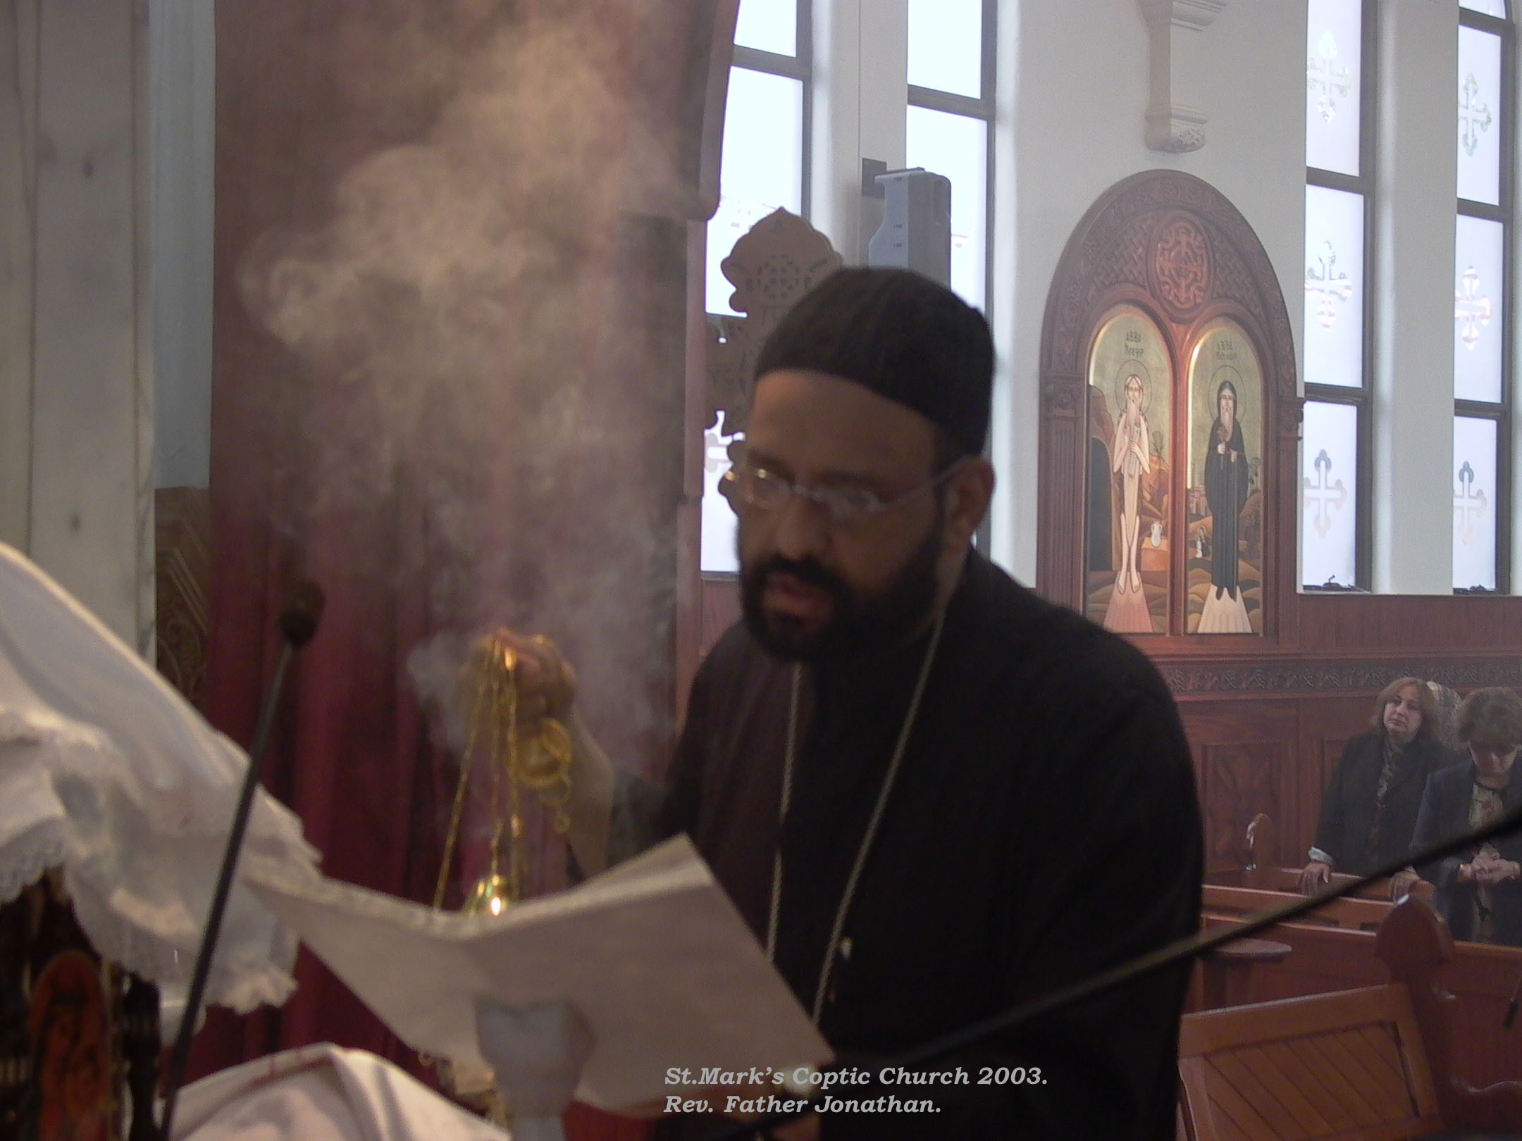
Sacrament of Eucharist.

Slide 12
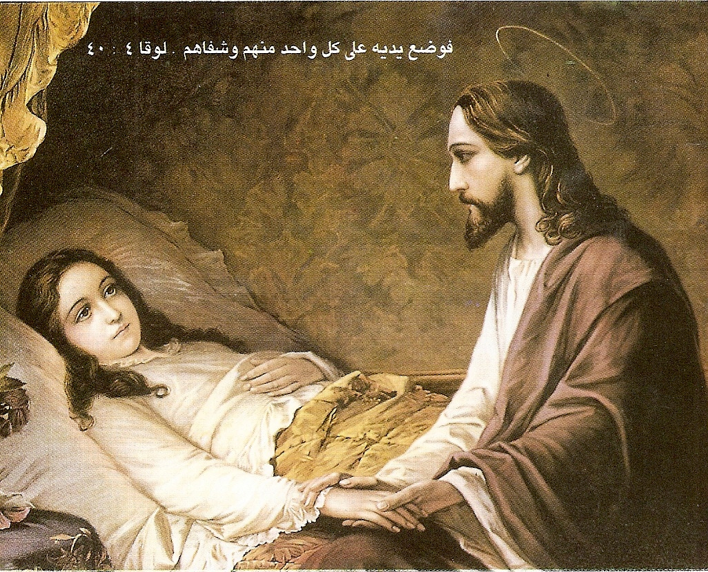
Sacrament of Unction of Sick.
The substance of the Sacrament of Unction of sick is oil, by which we receive physical and psychological remedy.

Slide 13
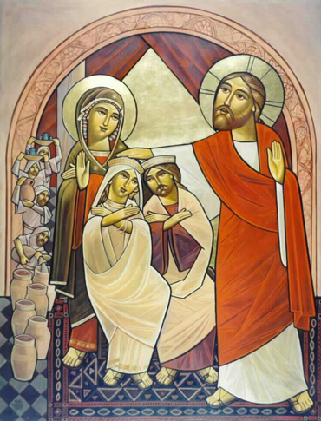
Sacrament of Matrimony.
The sign of the Sacrament of Matrimony is the bride and groom who receive the prayers, so the Holy Spirit dwells upon them and unites them in body and spirit.

Slide 14
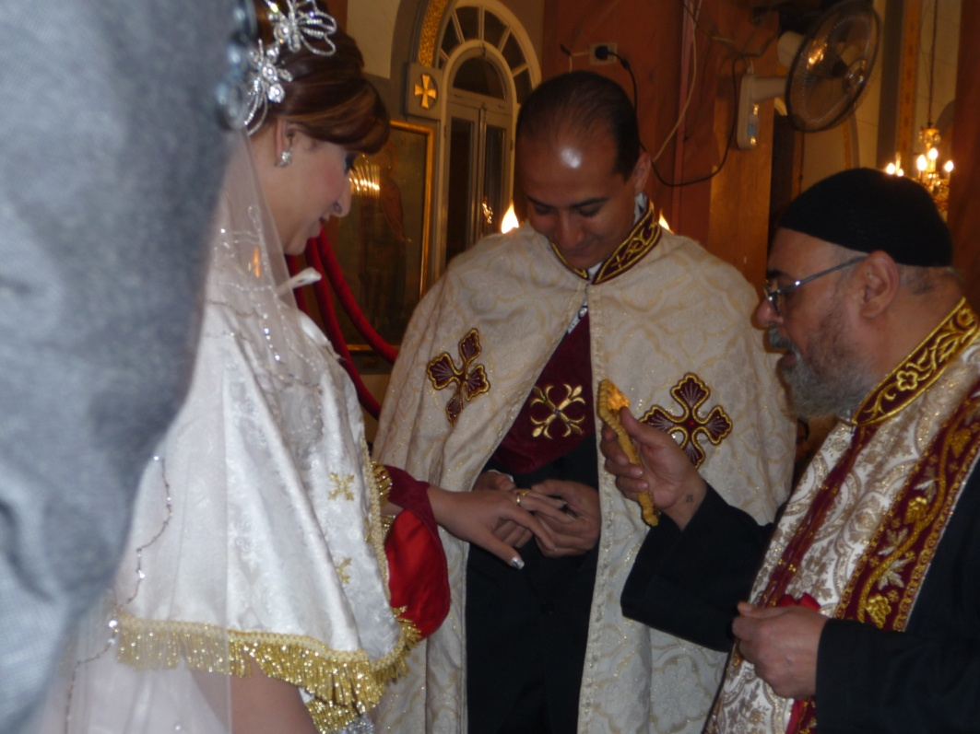
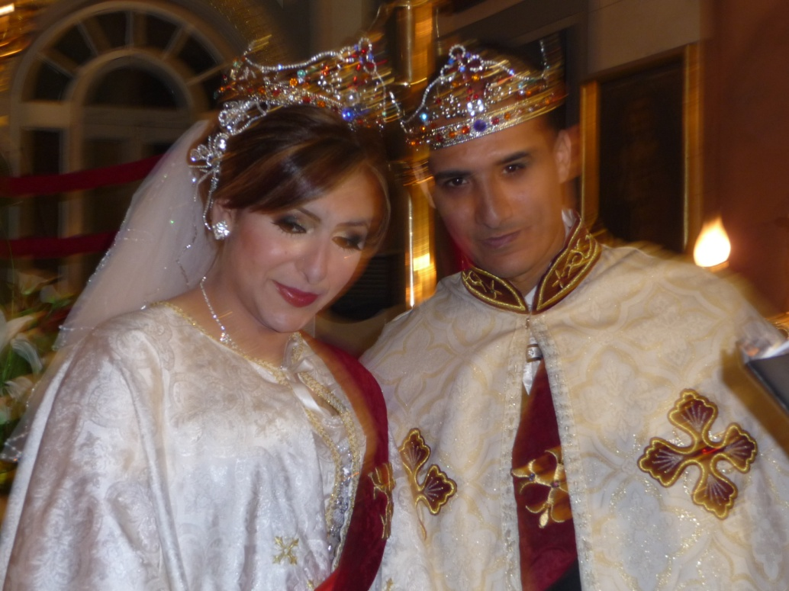
Sacrament of Matrimony.

Slide 15
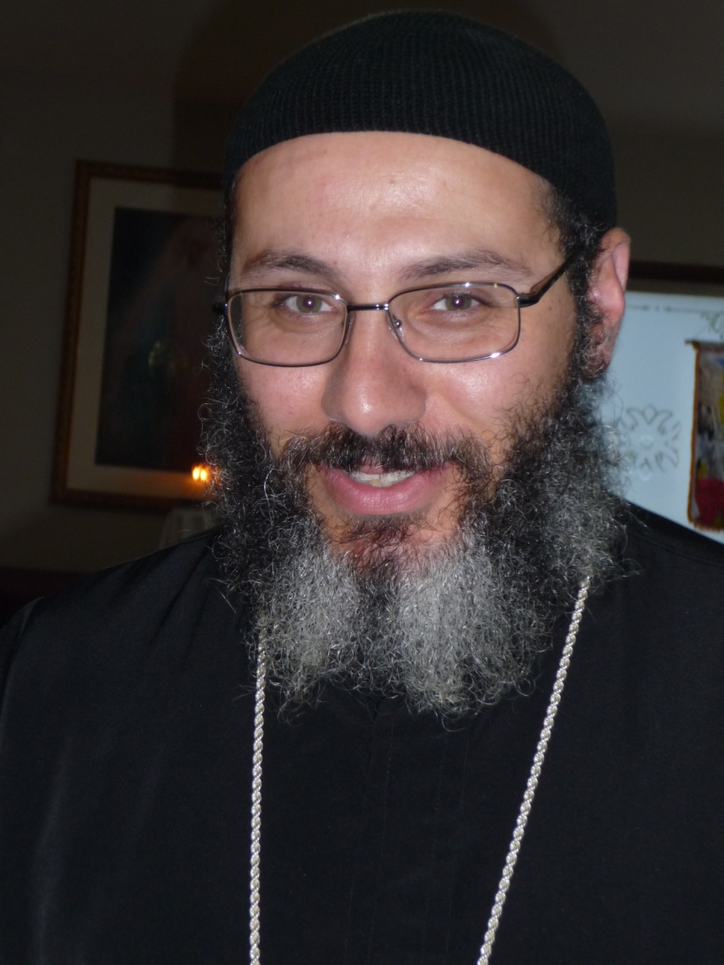
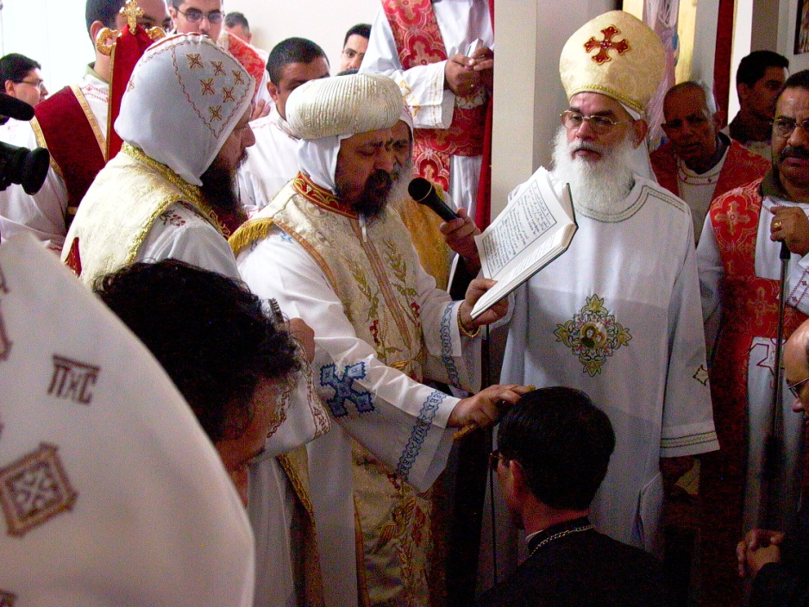
Sacrament of Priesthood.
The sign of the Sacrament of Priesthood is the ordained person,, who accepts the prayers of the Sacrament of Priesthood and the laying of hands for a certain priestly rank, to gain the grace for starting church services

Slide 16
Sacrament of Baptism
Instituted by the Lord Jesus by His Baptism in the River Jordan and by His words to Nicodemus saying.

Slide 17
Sacrament of Baptism
-“ Most assuredly I say to you, unless one is born again he cannot see the kingdom of God …. Most assuredly, I say to you, unless one is born of water and the Spirit, he cannot enter the Kingdom of God” (John 3).
And by saying to the Fathers the Apostles, “Go therefore and make disciples of all nations, baptizing them in the name of the Father and of the Son and of the Holy Spirit” (Matthew 28:19).
By Baptism we are made children of God our father, and this is imperishable.

Slide 18
Sacrament of Confirmation.
Instituted by the Lord Jesus when He said: “If anyone thirsts let him come to Me and drink. He who believes in Me, as the Scripture has said, out of his heart will flow rivers of living water”. (John 7:37

Slide 19
Sacrament of Confirmation.
But this He spoke concerning the Spirit whom those believing in Him would receive; for the Holy Spirit was not yet given, because Jesus was not yet glorified” (John 7:37-39).
About the Sacrament of Confirmation,
In the Book of Acts it is mentioned: “Now when the Apostles who were at Jerusalem heard that Samaria had received the Word of God, they sent Peter and John to them, who, when they had come down, prayed for them that they might receive the Holy Spirit. For as yet He had fallen upon none of them

Slide 20
Sacrament of Confirmation.
They had only been baptized in the name of the Lord Jesus. Then they laid hands on them, and they received the Holy Spirit. For as yet He had fallen upon none of them. They had only been baptized in the name of the Lord Jesus. Then they laid hands on them, and they received the Holy Spirit” (Acts 8:14-17).
By Chrism we are made soldiers of our great King, and this is imperishable.

Slide 21
Sacrament of Confession.
Instituted by the Lord Jesus when He said to His disciples: “Assuredly I say to you, whatever you bind on earth will be bound in heaven, and whatever you loose on earth will be loosed in heaven” (Matthew 18:18)

Slide 22
Sacrament of Confession.
And after Resurrection
Jesus said, “As the Father has sent me, I also send you and when had said this, He had said this, He breathed on them, and said to them “Receive the Holy Spirit. If you forgive the sins of any, they are forgiven them, if you retain the sins of any, they are retained” (John 20:21-22).

Slide 23
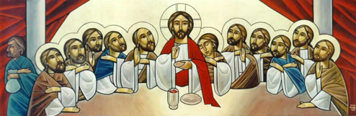
Sacrament of Eucharist.
“Take eat, this is My Body. (Mark 14:22-24)

Slide 24
Sacrament of Eucharist.
Instituted by the Lord Jesus in the upper room in Zion, on the night of His passion
when He took bread, blessed it and broke it, and gave it to His disciples saying, “Take eat, this is My Body. Then He took the cup, and they all drank from it and He said to them “This is My Blood of the new covenant which is shed for many” (Mark 14:22-24)

Slide 25
Sacrament of Unction of Sick.
Instituted by the Lord Jesus when He said to His disciples, “Heal the sick, cleanse the lepers” (Matthew 10:8),

Slide 26
and, “Whatever city you enter … heal the sick who are there” (Luke 10:8). The Apostles then put the Lord’s words into practice: “They anointed with oil many who were sick and healed them” (Mark 6:13).
Our teacher St. James the Apostle advised believers to practice it, by saying,
“Is anyone among you sick? Let him call for the elders (Priests) of the Church, and let them pray over him, anointing him with oil in the name of the Lord. And the prayer of faith will save the sick, and the Lord will raise him up, and if he has committed sins, he will be forgiven” (James 5:14-15).

Slide 27
Sacrament of Matrimony.
Instituted by the Lord Jesus who blessed the Sacrament of Matrimony by attending the wedding of Cana of Galilee

Slide 28
where He manifested His Glory, “¹¹This beginning of signs Jesus did in Cana of Galilee, and manifested His glory; and His disciples believed in Him. ( John 2:1-11)
Also, our teacher St. Paul says, ³²This is a great mystery, but I speak concerning Christ and the church.(Ephesians 5:32) .
This means that the physical union between a man and his wife is a sign and symbol of a great spiritual matter, that is, of the unity of heart and soul, resembling the unity of Christ and the Church.

Slide 29
Sacrament of Priesthood.
Instituted by the Lord Jesus when He chose His twelve disciples among many of His followers, and called them Apostles. The selection was accomplished after a whole night of prayer, when the Lord Jesus went out to the mountain to pray (Luke 6:12-13)

Slide 30
These twelve Jesus sent out and commanded them, saying: “Do not go into the way of the Gentiles, and do not enter a city of the Samaritans. ⁶But go rather to the lost sheep of the house of Israel. ⁷And as you go, preach, saying, ‘The kingdom of heaven is at hand.(Matthew 10:5-7).
The Lord said to them “ ¹⁶You did not choose Me, but I chose you and appointed you that you should go and bear fruit, and that your fruit should remain, that whatever you ask the Father in My name He may give you.(John 15:16)

Slide 31
He gave them the authority Matthew18:¹⁸“Assuredly, I say to you, whatever you bind on earth will be bound in heaven, and whatever you loose on earth will be loosed in heaven.
After the resurrection, the lord ( John 20:22,23)
And when He had said this, He breathed on them, and said to them, “Receive the Holy Spirit. ²³If you forgive the sins of any, they are forgiven them; if you retain the sins of any, they are retained

Slide 32
And to them only, He said
“¹⁸And Jesus came and spoke to them, saying, “All authority has been given to Me in heaven and on earth. 19 Go there-fore and make disciples of all the nations, baptizing them in the name of the Father and of the Son and of the Holy Spirit, 20 teaching them to observe all things that I have commanded you; and lo, I am with you always, even to the end of the age.” (Matthew 28:18-20).

Slide 33
Redemptive Vs. Non-Redemptive Sacraments
There are four redemptive Sacraments .They are necessary for eternal salvation
Baptism.
Confirmation.
Confession
Communion.
Sacrament of The Unction of the Sick
Sacrament of The Holy Matrimony
Sacrament of priesthood.

Slide 34
imperishable Vs. repeatedly as needed
Certain church Sacraments are performed with an imperishable
Baptism.
Confirmation.
Priesthood
But the rest 0f the Sacraments are performed repeatedly as needed.

