Slide 1
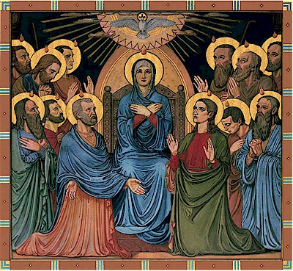
The Pentecost

Slide 2
Introduction
❖ Review the previous lesson and the verse.
❖ Use an icon or a picture of the apostles receiving the Holy Spirit during the day of Pentecost.
❖ Ask the children about what they see in the picture and if they can describe it.

Slide 3
Conclusion/Questions
❖ The disciples spent the 10 days before the Pentecost in fasting and prayers. The Holy Spirit filled their heart at the end giving them power from heaven.
❖ Lord now we all have the Holy Spirit in us from Baptism so give us the same power as you gave to your disciples.
❖ Where did the disciples go after the Ascension?
❖ What did they do while waiting?
❖ Why did they select additional apostle?
❖ What are the names of the twelve apostles?
❖ Who else was with the apostles?

Slide 4
Conclusion/Questions 2
❖ What happened the day of Pentecost?
❖ At what hour the Holy Spirit filled the apostles?
❖ What did the people think about them?
❖ How many were saved by one sermon from Peter?
Notes:
❖ The people laughed at the disciples and said: “they are completely drunk.” Hearing that, St. Peter stood up with the other disciples, and raised his voice and said to them, “These are not drunk, as you suppose, since it is only three o’clock in the afternoon”. St. Peter then started talking to the people about Jesus Christ and how He came to save them and that He rose from the dead.

Slide 5
Conclusion/Questions 3
❖ What did they do to join the new church?
❖ How did they live after that? Did anybody have a need to a thing?
❖ Why do we name this day the birthday of the church?
Notes:
❖ Now when they heard this, 3000 people believed and they asked the apostles “What shall we do?” The apostles answered “Repent, and let every one of you be baptized in the name of Jesus Christ and you shall get the gift of the Holy Spirit and all your sins will be cleaned. Then those who gladly listened to these words were baptized; and that day about three thousand souls were added to them.
❖ The new believers continued to gather with the rest of the Christians and shared with them the communion and the prayers. Then many wonders and miracles were done through the apostles.
❖ All who believed were together, and had all things in common, and sold all what they have and divided them among all, so every one would take what he needs only. They were glad when they shared food together and they were all simple in heart, praising God. And the Lord added many more people to the church daily and their number increased quickly.

Slide 6
Objective
❖ The children should feel the great love and care God gave to them when they received the Holy Spirit after being baptized.

Slide 7
Memory verse
“You shall receive power when the Holy Spirit has come upon you” (Acts 1:8).

Slide 8
References
❖ Luke 24:49-53, Acts 2
❖ The Holy Spirit and His Work in Us - H.H. Pope Shenouda III.

Slide 9
Applications
❖ Let us do what the apostles and the new believers did, share everything, love one another, pray and fast together.
❖ Go to the church together, play together, and take communion together.
❖ We also have to tell the children who don’t share that sharing is from God.

