Slide 2
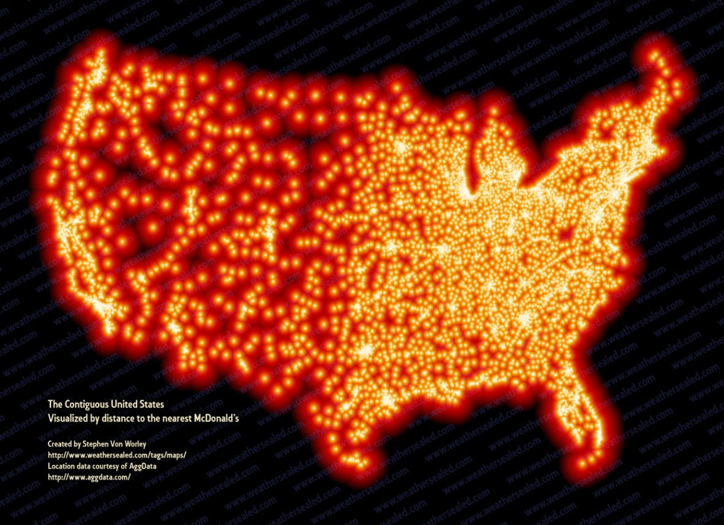

Slide 3
Giving
Tithes - Giving 10% of what you earn
First fruit offerings – Your first payment
Why should you give?

Slide 4
1. Giving to the poor = Giving to Christ
Matthew 25:37-46
³⁷ “Then the righteous will answer Him, saying, ‘Lord, when did we see You hungry and feed You, or thirsty and give You drink? ³⁸ When did we see You a stranger and take You in, or naked and clothe You? ³⁹ Or when did we see You sick, or in prison, and come to You?’ ⁴⁰ And the King will answer and say to them, ‘Assuredly, I say to you, inasmuch as you did it to one of the least of these My brethren, you did it to Me.’

Slide 5
Giving to the poor = Giving to Christ (opposite is true)
⁴¹ “Then He will also say to those on the left hand, ‘Depart from Me, you cursed, into the everlasting fire prepared for the devil and his angels: ⁴² for I was hungry and you gave Me no food; I was thirsty and you gave Me no drink; ⁴³ I was a stranger and you did not take Me in, naked and you did not clothe Me, sick and in prison and you did not visit Me.’
⁴⁴ “Then they also will answer Him,^{[a]} saying, ‘Lord, when did we see You hungry or thirsty or a stranger or naked or sick or in prison, and did not minister to You?’ ⁴⁵ Then He will answer them, saying, ‘Assuredly, I say to you, inasmuch as you did NOT do it to one of the least of these, you did not do it to Me.’ ⁴⁶ And these will go away into everlasting punishment, but the righteous into eternal life.”

Slide 6
2. We give God from what is His
1 Chronicles 29:14
“But who am I, and who are my people, That we should be able to offer so willingly as this? For all things come from You, And of Your own we have given You”

Slide 7
2. We give God from what is His
Job 1:21
“Naked I came from my mother’s womb, And naked shall I return there. The Lord gave, and the Lord has taken away; Blessed be the name of the Lord.”

Slide 8
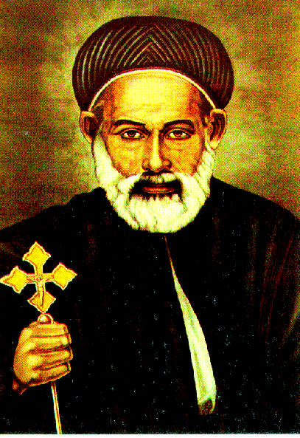
St Abraam -
The Friend of the Poor

Slide 9
2. We give God from what is His
Robbing God
- “Will a man rob God? Yet you have robbed Me! But you say, ‘In what way have we robbed You?’ In tithes and offerings. ⁹ You are cursed with a curse, For you have robbed Me” Malachi 3:8-9

Slide 10
St Abraam -
The Friend of the Poor

Slide 11
Misquoted GAME!
“God loves those who give”
“So let each one give as he purposes in his heart, not grudgingly or of necessity; for God loves a cheerful giver.” 2 Corinthians 9:7

Slide 12
Misquoted GAME!
“Money is the root of all evil”
“For the love of money is a root of all kinds of evil, for which some have strayed from the faith in their greediness” 1 Timothy 6:10

Slide 13
Misquoted GAME!
“If you want to be a good person, go, sell what you have and give to the poor”
“Jesus said to him, “If you want to be perfect, go, sell what you have and give to the poor, and you will have treasure in heaven; and come, follow Me.” Matthew 19:21

Slide 14
3. Giving secretly has rewards
Matthew 6:1-4
“Take heed that you do not do your charitable deeds before men, to be seen by them. Otherwise you have no reward from your Father in heaven. ² Therefore, when you do a charitable deed, do not sound a trumpet before you as the hypocrites do in the synagogues and in the streets, that they may have glory from men. Assuredly, I say to you, they have their reward. ³ But when you do a charitable deed, do not let your left hand know what your right hand is doing, ⁴ that your charitable deed may be in secret; and your Father who sees in secret will Himself reward you openly.

Slide 15
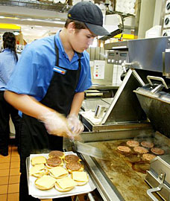
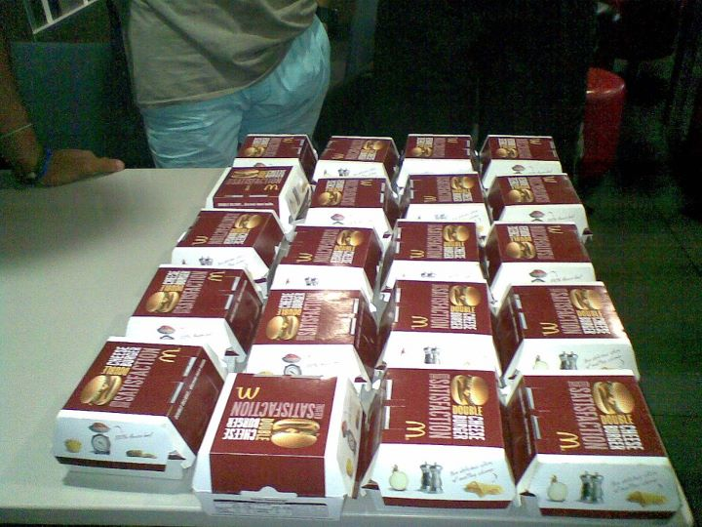

Slide 16
4. Quality not Quantity
Luke 21:1-4
And He looked up and saw the rich putting their gifts into the treasury, ² and He saw also a certain poor widow putting in two mites. ³ So He said, “Truly I say to you that this poor widow has put in more than all; ⁴ for all these out of their abundance have put in offerings for God,^{[a]} but she out of her poverty put in all the livelihood that she had.”

Slide 17
The Other Side
Video

Slide 18
Summary
Giving to the poor = Giving to Christ
We give God from what is His
Giving secretly has rewards
Quality not Quantity

