Slide 1
Intercessions

Slide 2
What is intercession
To intercede means to act between parties with a view to reconcile differences (Webster Dictionary). Intercession is actions by those who are more able than we are in our behalf.

Slide 3
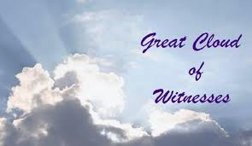

Slide 4
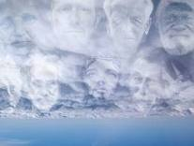
the Church refers to those saints who intercede on our behalf as the “Cloud of Witnesses” (Hebrews 12:1-2): “Therefore we also, since we are surrounded by so great a cloud of witnesses, let us lay aside every weight, and the sin which so easily ensnares us, and let us run with endurance the race that is set before us, looking unto Jesus, the author and finisher of our faith, who for the joy that was set before Him endured the cross, despising the shame, and has sat down at the right hand of the throne of God”.

Slide 5
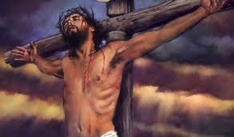
The Redemptive Intercession

Slide 6
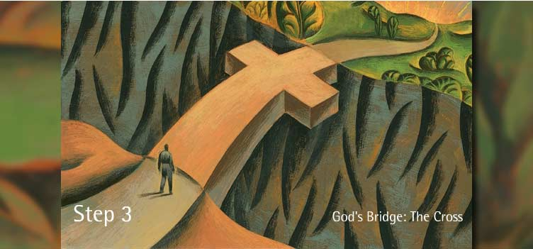

Slide 7
The Redemptive Intercession was the act of Jesus Christ on the cross. Christ is the only reconciliator between God the Father and man in salvation. There is no other savior or redeemer as it is clearly stated by St. Paul “Not with the blood of goats and calves, but with His own blood He entered the Most Holy Place once for all, having obtained eternal redemption” (Hebrews 9:12).

Slide 8
Other Intercessors

Slide 9
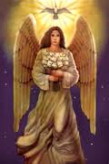
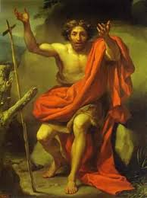
St. Mary, the Archangels, the Angels, and St. John the Baptist.

Slide 10
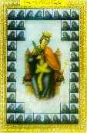
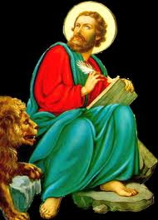
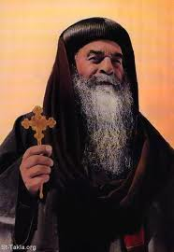
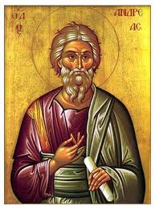
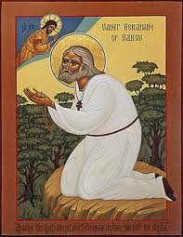
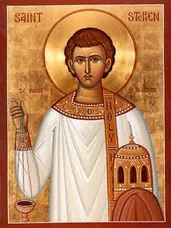
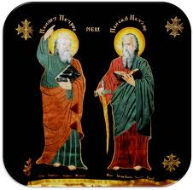
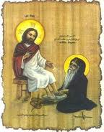
Disciples, Apostles, Prophets, Martyrs, Saints, and all those who please God (past, present, and future) in their deeds.

Slide 11
How do we Know there is Intercessions?

Slide 12
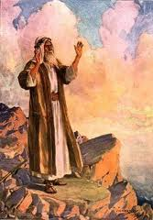
The Israelites asked Moses to pray on their behalf “Therefore the people came to Moses, and said: We have sinned, for we have spoken against the Lord and against you; pray to the Lord that He take away the serpents from us.

Slide 13
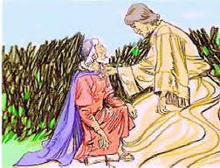
Do not fear, Daniel, for from the first day that you set your heart to understand, and to humble yourself before your God, your words were heard; and I have come because of your words” (Daniel 10:10-12)

Slide 14
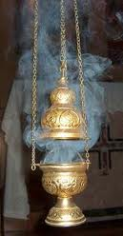
Then another angel, having a golden censer, came and stood at the altar. He was given much incense, that he should offer it with the prayers of all the saints upon the golden altar which was before the throne” (Revelation 8:3)

Slide 15
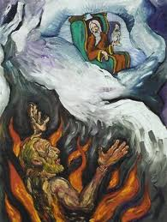
“But there was a certain beggar named Lazarus, full of sores, who was laid at his gate, desiring to be fed with the crumbs which fell from the rich man's table. Moreover the dogs came and licked his sores. So it was that the beggar died, and was carried by the angels to Abraham's bosom.

Slide 16
The rich man also died and was buried. And being in torments in Hades, he lifted up his eyes and saw Abraham afar off, and Lazarus in his bosom. Then he cried and said: Father Abraham, have mercy on me, and send Lazarus that he may dip the tip of his finger in water and cool my tongue; for I am tormented in this flame.

Slide 17
But Abraham said: Son, remember that in your lifetime you received your good things, and likewise Lazarus evil things; but now he is comforted and you are tormented. And besides all this, between us and you there is a great gulf fixed, so that those who want to pass from here to you cannot, nor can those from there pass to us.

Slide 18
Then he said, 'I beg you therefore, father, that you would send him to my father’s house, for I have five brothers, that he may testify to them, lest they also come to this place of torment. Abraham said to him: They have Moses and the prophets; let them hear them. And he said: No, father Abraham; but if one goes to them from the dead, they will repent. But he said to him: If they do not hear Moses and the prophets, neither will they be persuaded though one rise from the dead” (Luke 16:20-31).

Slide 19
What Can Intercessors Do?

Slide 20
1. Intercede: St. Mary, Angels, Archangels, John the Baptist Intercede in our behalf to the Lord.

Slide 21
2. Pray: All the others pray on our behalf before the Lord.

Slide 22
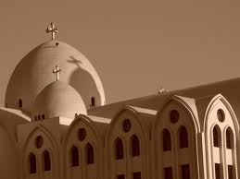
Intercession In the Church
The Church asks for the intercessions of all the saints all the time. It takes faith for these intercessions to bring fruits. In the Raising of Incense: we start with praises: Psali (Psalms unto the Lord), Theotekia (Magnifying the Theotokos), and Doxologia (Glorifications for the saints).

Slide 23
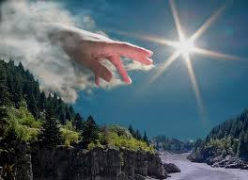
Value of Intercessions
Through Intercession and Prayers, we are assured of our Salvation. In a sense we see the saints as mentors-as examples of people “who did it”. Through intercessions, we receive help with problems: Spiritual and Physical-a clear assurance that God is working in our life.

Slide 24
Examples from the Old Testament

Slide 25
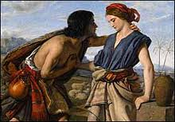
Jacob for Rachel: Rachel was barren, and through the intercession of her husband she bore Joseph and Benjamin. She cried to her husband and in turn he cried to God.

Slide 26
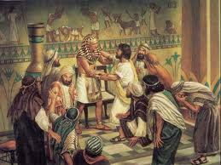
Joseph for Egypt and His Brothers: Joseph certainly interceded for Egypt by his wisdom and prayers, they were saved from famine. He also saved his eleven brothers from famine.

Slide 27
Examples from the New Testament

Slide 28
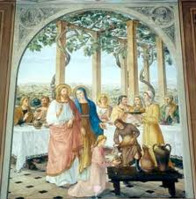
St. Mary (Theotokos) asked her Son, and He provided heavenly wine at the wedding in Canna of Galilee, it is the first miracle recorded in the gospel.

Slide 29
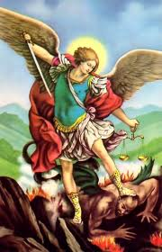
Archangel Michael is the first in the Archangels as we sing in the praises. His Intercessions are very powerful.

Slide 30
Conclusion
Intercession is a powerful tool available to all believers. By asking the intercession and prayers of the saints, we receive help from the heavenly host. We should use it always. May their Holy Blessing be with us all. Intercessions are means of unifying the earthly with the heavenly church.

