Slide 1
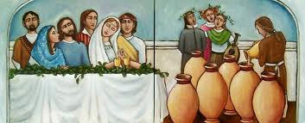
The Wedding at Cana

Slide 2
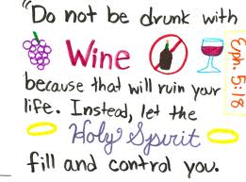

Slide 3
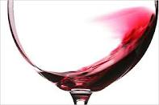
Water Turned to Wine John 2:1-10
¹ On the third day there was a wedding in Cana of Galilee, and the mother of Jesus was there. ² Now both Jesus and His disciples were invited to the wedding. ³ And when they ran out of wine, the mother of Jesus said to Him, “They have no wine.” ⁴ Jesus said to her, “Woman, what does your concern have to do with Me? My hour has not yet come.” ⁵ His mother said to the servants, “Whatever He says to you, do it.” ⁶ Now there were set there six water pots of stone, according to the manner of purification of the Jews, containing twenty or thirty gallons apiece. ⁷ Jesus said to them, “Fill the water pots with water.” And they filled them up to the brim. ⁸ And He said to them, “Draw some out now, and take it to the master of the feast.” And they took it. ⁹ When the master of the feast had tasted the water that was made wine, and did not know where it came from (but the servants who had drawn the water knew), the master of the feast called the bridegroom. ¹⁰ And he said to him, “Every man at the beginning sets out the good wine, and when the guests have well drunk, then the inferior. You have kept the good wine until now!”

Slide 4
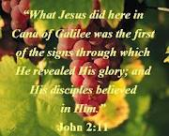

Slide 5
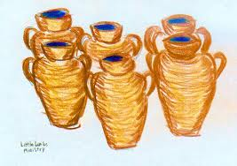
The Symbolic Meaning
This nice story has deep meanings. There were six jars of stone standing, for the Jewish rites of purification. The Jews considered the number of seven as the complete number. So number of six indicates incompleteness. Here is an indication that Jesus completed what the Old Testament was lacking in his first miracle thus declaring the beginning of the New Testament.

Slide 6
The Symbolic Meaning
The beloved John gives another comment. Each stone jar held twenty or thirty gallons of water. This means that Jesus offered the guests about one hundred and eighty gallons of wine. The guests of a simple rural party whatever their number was, could not consume this. Here is an indication of the rich and abundant grace of God

Slide 7
Should Jesus be going to wedding receptions?

Slide 8
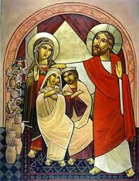
Christ’s Social Participation
Lord Jesus attended the wedding party at Cana in Galilee together with his disciples. He also accompanied them to Lazarus’s tomb (Rejoice with those who rejoice, weep with those who weep). Christian participation is not a formal one neither is it a sort of social behaviour but it is a response to a cordial call as it is participation within the frame of truth. A Christian man is not prepared to participate in the works of darkness but he reproaches them. May our hearts be gentle and decent and share all the people in their feelings, in deep love and in complete obedience to truth.

Slide 9
Was Jesus disrespecting His mother when he said “Woman, what does your concern have to do with Me? My hour has not yet come.” ?

Slide 10
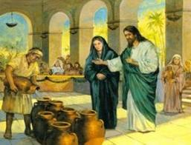
Christ obeys his mother
He knew that his hour had not come yet “O woman what have you to do with me?” (This style does not mean that Christ despised his mother because it was he who demanded that we should honour our parents, so he could not despair his mother), the word “woman” here means “Lady”... She knew that He loved her and obeyed her “Do whatever He tells you”. This reveals the importance of intercession of the Virgin Mary as she knew His will more than all other people and she was obedient to him so our prayers are acceptable when we ask for her intercession

Slide 11
So Jesus made wine for others, so it must be ok to drink?

Slide 12
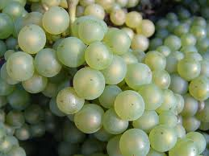
The Christian attitude towards wine
There is nothing defiled in Christianity concerning food and drinking “Not what goes into the mouth defiles a man” (Mathew 15:11). The problem lies in the sort of that thing and the way of using it. The good wine is used in the Church to be turned into the blood of Christ.

Slide 13
The Christian attitude towards wine
“Do not get drunk with wine, for that is debauchery; but be filled with the Spirit” (Ephesians 5: 18). Either we are comforted by the Spirit or enjoy the wine of this world and perish. Thus the following principles restrict the Christian man’s behaviour towards wine, the cinema and all social matters”.
“All things are lawful for me, but not all things are helpful” (1 Corinthians 6:12, 10:23).
“All things are lawful for me but I will not be enslaved by anything” (1 Corinthians 6:12).
“All things are lawful but not all things build up” (1 Corinthians 10:23).
“If food is a cause of my brother’s falling, I will never eat meat” (1 Corinthians 8:13).

Slide 14
The turning of water to wine was Jesus’ first miracle. What His last miracle?

Slide 15
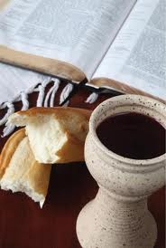
The Problem of Wine at Cana in Galilee
The first miracle that Jesus Christ performed was turning the water into wine and the last miracle He performed was turning wine into his own blood. That marks the way of spiritual life that has now become clear…Water then wine then blood. This means that the normal natural life of the body (water) contacts with Christ in (wine) His love and this in its turn qualifies man to receive Christ’s Holy Body (and Blood). The good wine, which Christ offered, refers to Christ’s purification of the instincts of man in the mystery of marriage.

Slide 16
How do the empty jars resemble the coming of Christ?

Slide 17
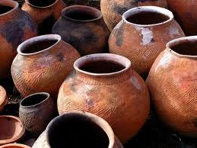
The Problem of Wine at Cana in Galilee
The stone jars were empty indicating that the old rites of purification did not succeed in purifying man. In fact the word of God alone purifies man and when He said, “Fill the jars with water” the water brought people back to reason, as it was the word of God that worked and had its great effect on people. The word of God gave the water in the jars an abundant power. The wine, which Jesus gave, did not deprive people of their senses. The wine of Cana in Galilee refers to Christ’s love “For your love is better than wine” (The Song of Solomon 1:2, 4:10).

