Slide 1
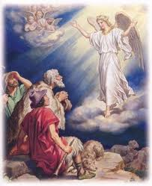
The Angels, Their Praises & Their Services to the People
To feel the presence of the angels.
To learn about the service of the angels.

Slide 2
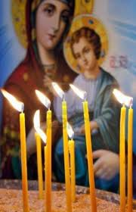
Tapers lit in the church put before the Saints and Angels
Where are tapers lit in the Church?
What do we put before the pictures of the Saints?
What do we put before the pictures of the angels?
Why do we light tapers?

Slide 3
Memory Verse
“The Angel of the Lord encamps around those who fear him, and delivers them” (Psalms 34:7).

Slide 4
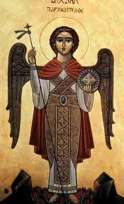
Lesson Outline
A man and his wife loved God and the poor. The man’s name was Dorthaus and the woman’s name was Thaoupesta. They used to make a feast for the poor on the feast of the archangel Michael (called the Angel Day). The Lord blessed them and gave them wealth and property. Every year they made a feast for the poor on the Feast day Angel.
One year they had no money neither did they have any food to offer. They were sad because they were unable to make a feast for the poor that year on the occasion of the Feast day of the Angel

Slide 5
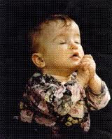
Applications
When we pray before we go to bed the Lord will send an angel to guard us all night long. The angel will also protect us from bad thoughts and bad dreams.

Slide 6
Conclusion
God created the Angels of light. They are present before Him day and night praising Him without pause.
They make intercession for the people and they are responsible for the children of God. “For He will give His angels charge of you to guard you in all your ways” (Psalms 91:11).
Hand out Images of Angels/Archangel Michael

Slide 7
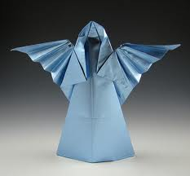
Activities
Bring material to the children to make angels in class and take them home and put them in their bedrooms.
Show them the (Fetir) of Archangel Michael

Slide 8
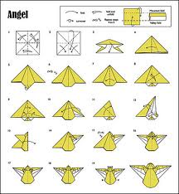
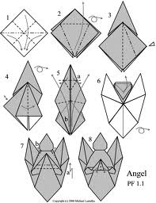
Origami Angel

